Slide 1
NYS Reporting & High School Data
What Charter Schools Need to Know

Slide 2
Graduates

Slide 3
Annual Grad Data
Total Cohort Data
Any student who graduates in the current school year
Students who graduate any time between August 2020 – June 2021
A fifth-year senior who graduates by June 30, 2021 will appear in the SIRS-308 Annual Grad report for 2020-2021 SY
Class of 2021
Based on the First Date of Entry into Grade 9
Students who first entered grade 9 in the 2017-18 school year are part of the 2017 Cohort
A fifth-year senior is part of the 2016 Cohort regardless of when they graduate
2017 Cohort
Annual Grad Data is used to update Total Cohort Data.
Total Cohort Data is used for Graduation Rate in the School Report Card and in High School Graduation Rate Data

Slide 4
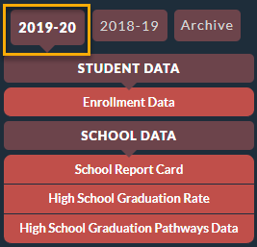
A big ball of wibbly wobbly, timey wimey stuff
The 4-, 5-, & 6-year graduation rate in the School Report is lagged one year. The 2019-2020 School Report Card uses 2015, 2014 and 2013 Cohort Data.
High School Graduation Rate is as of the 4th year of high school - August. The 2019-2020 High School Graduation Rate and High School Graduation Pathways Data uses 2016 Cohort Data as of August of 2020.

Slide 5
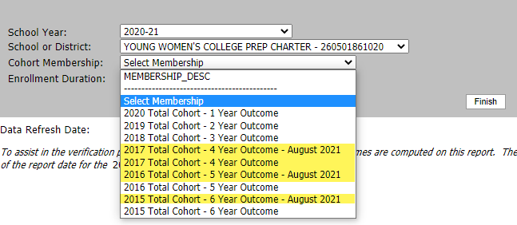
Total Cohort Data
Based on the First Date of Entry into Grade 9
Used in calculations for School Report Card, HS Graduation Rate and HS Graduation Pathways Data on data.nysed.gov
The 2020-2021 Graduation Rate and Graduation Pathways Data will use the 2017 Total Cohort Graduation Rate data which includes:
2017 Total Cohort, 4-Year - August
2016 Total Cohort, 5-Year - August
2015 Total Cohort, 6-Year - August
The 2020-2021 School Report Card will use the 2016 Total Cohort Graduation Rate to calculate Graduation Rate Level under ESSA which includes:
2016 Total Cohort, 4-Year - August
2015 Total Cohort, 5-Year - August
2014 Total Cohort, 6-Year - August
Verification
SIRS-201 Total Cohort – Summary
SIRS-202 Total Cohort – Assessment Summary
SIRS-203 Total Cohort Career Pathways Summary
L2RPT – SIRS-201 Total Cohort - Summary

Slide 6
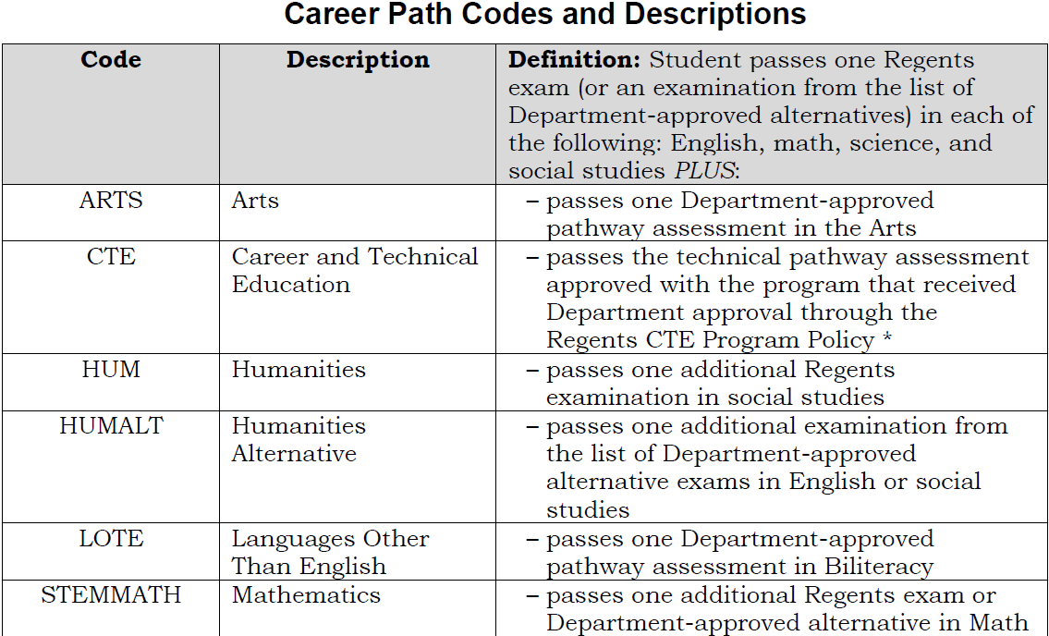
Annual Grad Data
Demographic data (Student Lite)
First Date of Entry in Grade 9 (defines Cohort)
Diploma/Credential Type
Diploma – Regents or Local
Credential – CDOS or Skills & Achievement
Career Path
Enrollment (School Entry/Exit)
Exit Date: Graduation date (before 6/30)
Reason for Ending Enrollment
Verification
SIRS-307 Annual Dropout & Noncompleter Report
SIRS-308 Annual Graduation Report

Slide 7
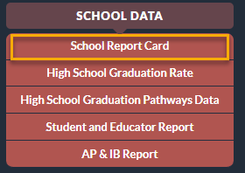
CDOS Credential
8271 - CDOS Credential Eligible Coursework (Programs Fact)
Both SWD and Gen Ed students may earn a Career Development and Occupational Studies credential
8271 identifies students who have earned a Regents or Local diploma AND a CDOS credential
Start Date: date student began CTE coursework and/or work-based learning
Exit Date: Graduation date or last day of school
Reason:
700 Received CDOS Credential
701 Left program without receiving CDOS
Verification
SIRS-401 Reasonableness Report
SIRS-308 Annual Graduation Report
data.nysed.gov
College, Career and Civic Readiness
CCCR Measure | Weighting
Regents Diploma or Local Diploma with Career Development and Occupational Studies (CDOS) endorsement | 1.5

Slide 8
Seal of Biliteracy
8312- Received Seal of Biliteracy (Programs Fact)
Identify students who have earned a Regents diploma and a NYS Seal of Biliteracy
Start Date: date received Seal of Biliteracy
No Exit Date needed
Verification
SIRS-401 Reasonableness Report
SIRS-308 Annual Graduation Report
data.nysed.gov
College, Career and Civic Readiness
CCCR Measure | Weighting
Regents Diploma with Seal of Biliteracy and a member of the cohort | 2.0
Regents Diploma with Seal of Biliteracy and ELL in current reporting year but not a member of the cohort | 2.0
Charter Schools offering the Seal of Biliteracy
Eugenio Maria de Hostos Charter School
New Visions Charter HS for the Humanities II
The American Dream School
New Visions Charter HS for Advanced Math and Science II
Uncommon Charter High School
New Visions Charter HS for Advanced Math and Science III
MESA Charter HS

Slide 9
Other Grades 9-12 Data

Slide 10
Assessments (Assessment Fact)
Regents
Report Regents Scores for June Algebra I CC, ELA CC, Living Environment, and Earth Science
Report Exemptions for ALL Aug, Jan, and Jun Regents Exams
AP and IB Assessments
Report AP and IB scores when they are available in July/August
If exam is an Alternate Regents exam, you will need to report Exemptions as well
NYSITELL
Report throughout the year
Verification
SIRS-303 Annual Secondary Assessment Summary Report
SIRS-309 Annual Regents Report
data.nysed.gov
Secondary Composite Performance
ELA & Math Academic Progress
English Language Proficiency
College, Career and Civic Readiness
CCCR Measure | Weighting
Regents Diploma and score of 3 or higher on an Advanced Placement (AP) exam | 2.0
Regents Diploma and score of 4 or higher on International Baccalaureate (IB) exam | 2.0

Slide 11
Course Data
Student Class Entry/Exit Template
Dual Credit Courses - Be sure that the Dual Credit Indicator is checked “Yes” on the course section
AP and IB courses should be mapped to appropriate AP and IB state course codes (Course Template)
Student Class Grade Detail Template
Need a Student Class Grade Detail record for all students in K-12 courses who have a Student Class Entry Exit record unless all the following are true:
No grade or other outcome is awarded for the class;
No credit is earned for the class; and
The linkage is not reflected on the student's report card or transcript.
Course Outcome
P – pass
F – fail
N – not complete
Credits Attempted and Earned required for grades 7-12 and ungraded secondary
Credit Recovery
Verification
SIRS-108 College Career and Civic Readiness
SIRS-321 Student Class Grade Verification Report
data.nysed.gov
College, Career and Civic Readiness
CCCR Measure | Weighting
Regents Diploma and high school credit earned through participation in a dual enrollment (in high school and accredited college) course | 2.0
Regents Diploma and high school credit earned through participation in an AP or IB (in high school and accredited college) course | 1.5

Slide 12
Suspension
SIRS Templates
Day Calendar
Student Attendance Codes
Student Daily Attendance
Suspension
In-School Suspension - ISS
Out-Of-School Suspension – OSS
You will also need to report an attendance code and learning modality for each day a student is reported with a suspension
Verification
SIRS-110 Student Daily Suspension Accountability Report
SIRS-111 School Year Suspension Accountability Report
SIRS-371 Student Attendance Count Report
SIRS-375 Student Attendance Count (By District) Report
data.nysed.gov
Suspension

Slide 13
Attendance
SIRS Templates
Day Calendar
Student Attendance Codes
Student Daily Attendance
Student Daily Attendance
There should be an attendance code for each day a student is enrolled in school
Present
Absent
Excused
Unexcused
Tardy
Verification
SIRS-360 Student Attendance Daily Summary
SIRS-361 Year to Date Attendance/Absenteeism Summary Report
SIRS-370 Day Calendar Summary Report
SIRS-371 Student Attendance Count Report
SIRS-375 Student Attendance Count (by District)
data.nysed.gov
Chronic Absenteeism

Slide 14
English Language Learners
All ELLs are reported with these program services (Programs Fact)
0231 – ELL Eligible
One ELL Program Service Code
5709 English as New Language
5676 Transitional Bilingual Education
5687 One Way or Two Way Dual Language
8239 ELL Eligible but not in an ELL Program
Verification
SIRS-401 Reasonableness Report
SIRS-650 English Language Learner Profile Report
data.nysed.gov
English Language Proficiency

Slide 15
Reporting Due Dates
NYSED’s L2RPT verification and data certification requirements are the same for all NY state charter schools
Specific deadlines for entering this data and help desk support can vary based on your Regional Information Center
NYC Charter Schools: The NYC Department of Education is the data center for charter schools in the NYC and a majority of this data is reported to the DOE via unique NYC data systems

